Slide 1

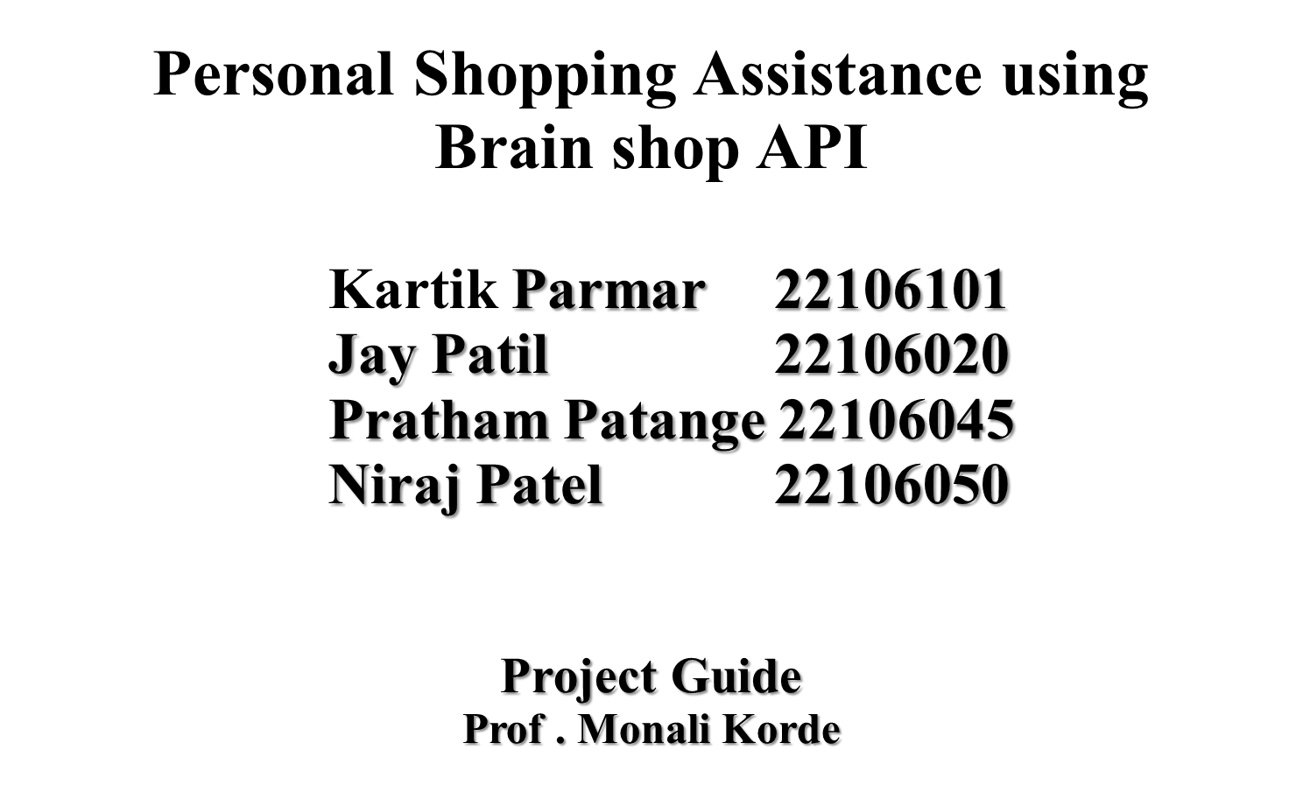

Slide 2
Outline
Introduction
Literature Survey of the existing systems
Problem statement
System Design
Technologies and methodologies
Implementation
Conclusion
References

Slide 3
Introduction
In India we have a traditional method to purchase items from shop. To break this traditional chain we are introducing shop bot using this we can purchase online items even if we are at home.
The shop bot not only purchases a item but also gives answers to the users question.
Now a days many big brand business are going online and they are inventing online apps ,but these apps are not interactive so to archive the interactive shopping we are coming up with shop bot

Slide 4
Objective
To facilitate the sale of mobile phones through the app. This involves providing users with a seamless shopping experience, including easy browsing, comparison of different phone models, secure payment options, and efficient delivery services.
To educate users about various aspects of mobile phones. This could include providing detailed product descriptions, specifications, and features of different phone models.
To providing a user-friendly interface and seamless navigation experience within the app. This involves optimizing the app's design, layout, and functionality to ensure ease of use and accessibility for all users.
To attract users by providing value-added incentives for purchasing phones through the app.

Slide 5
Literature Survey
Title of Paper | Author | Description | Link
[1]Shopbots and pricebots | Greenwald, Amy R., and Jeffrey O. Kephart. | Shopbots are software agents that automatically gather and collate information from multiple on-line vendors about the price and quality of consumer goods and services | https://link.springer.com/chapter/10.1007/10720026_1
[2]The impact of shopbot use on prices and price dispersion | Tang, Zhulei, Michael D. Smith, and Alan Montgomery | A period of rapid expansion in shopbot use. We find that a 1% increase in shopbot use is correlated with a $0.41 decrease in price levels and a 1.1% decrease in price dispersion. | https://www.sciencedirect.com/science/article/abs/pii/S0167718710000469
[3] Design and Implementation of an Android Application for Smart Shopping | Rajesh Kannan Megalingam, Souraj Vishnu, Swathi Sekhar, Vishnu Sasikumar, Sreekumar s & Thejus R Nair | The growth of Android applications around the world is extraordinary. People turn towards technology for making their life more innovative and find solutions to their daily problems. When it comes to shopping, customers find it very difficult to find their products around the supermarket as well as to stand in long billing counter queues. | https://ieeexplore.ieee.org/abstract/document/8698109
[4]"Designing interaction for chatbot-based conversational commerce with user-centered design | Pricilla, Catherine, Dessi Puji Lestari, and Dody Dharma. | An interaction and interface design for chatbot-based conversational commerce are developed in this study using user-centered design. The outcome of this study is a prototype that fulfills the usability goal and the user experience goal defined for chatbot-based conversational commerce on mobile platform especially for Indonesian users. | https://ieeexplore.ieee.org/abstract/document/8541320

Slide 6
Problem statement
To provide an local shop an Online platform for their products and give customers a reliable shopping Experience.

Slide 7
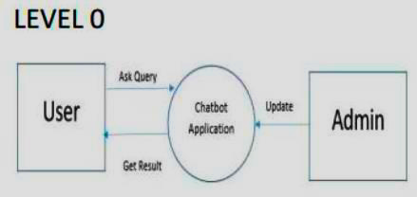
System Design
Fig 5.1.2 DFD Level 0

Slide 8
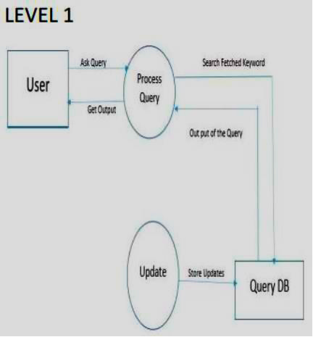
Fig 5.1.3 DFD Level 1

Slide 9
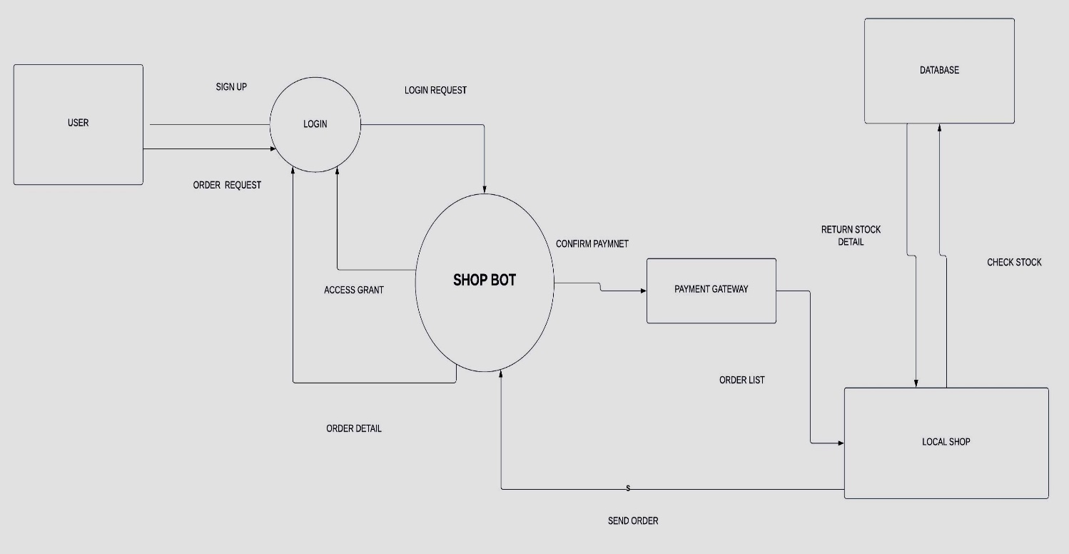
BLOCK DIAGRAM

Slide 10



Technologies and methodologies
Software Requirement
Platform :- Windows
Database :- Firebase store
Frame Work:- Android Studio
Development Tool:- Android Studio
Language:- Java, Xml
API:-Brainshop API

Slide 11
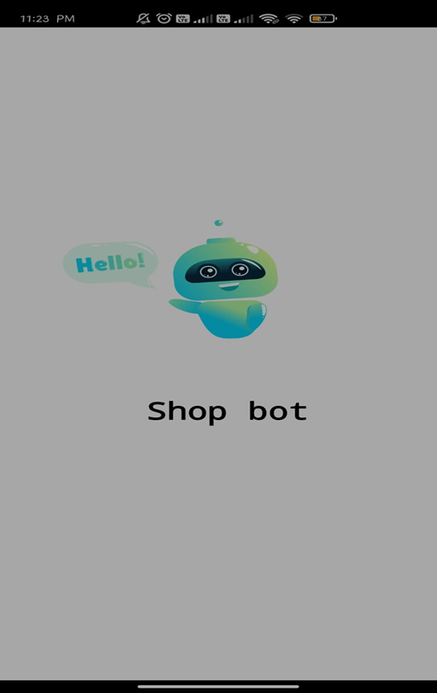
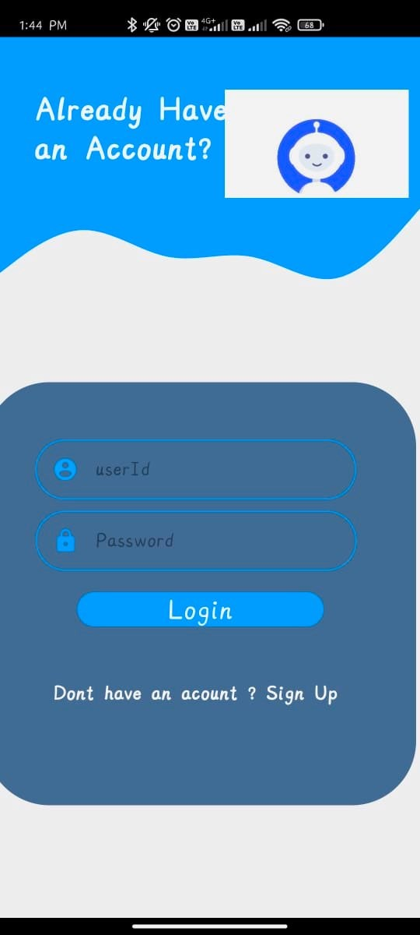
Implementation
Initial Page
Login Page.

Slide 12
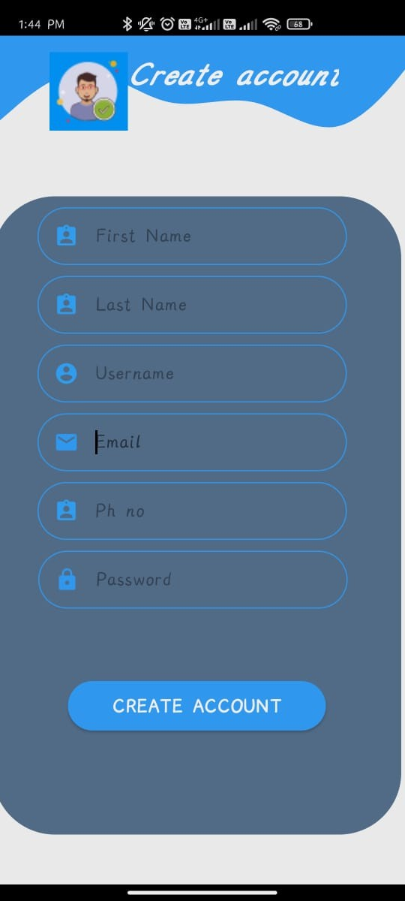
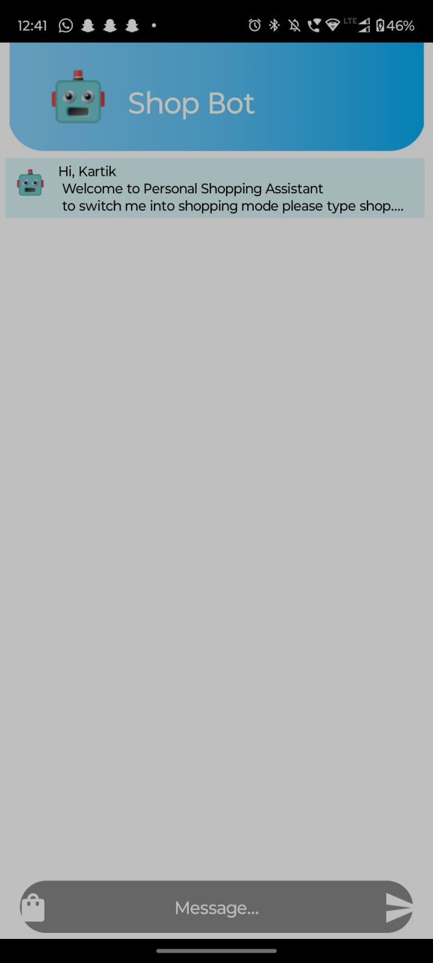
Register Page
Chat Screen.

Slide 13
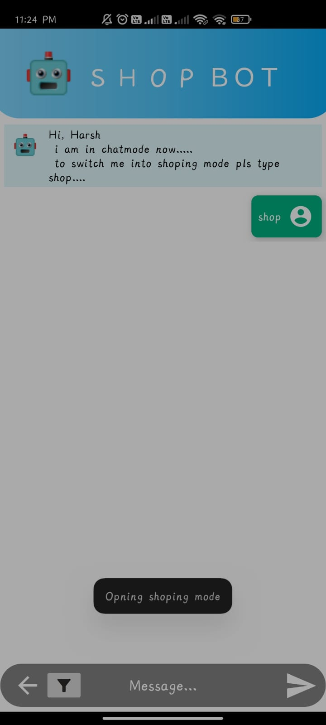
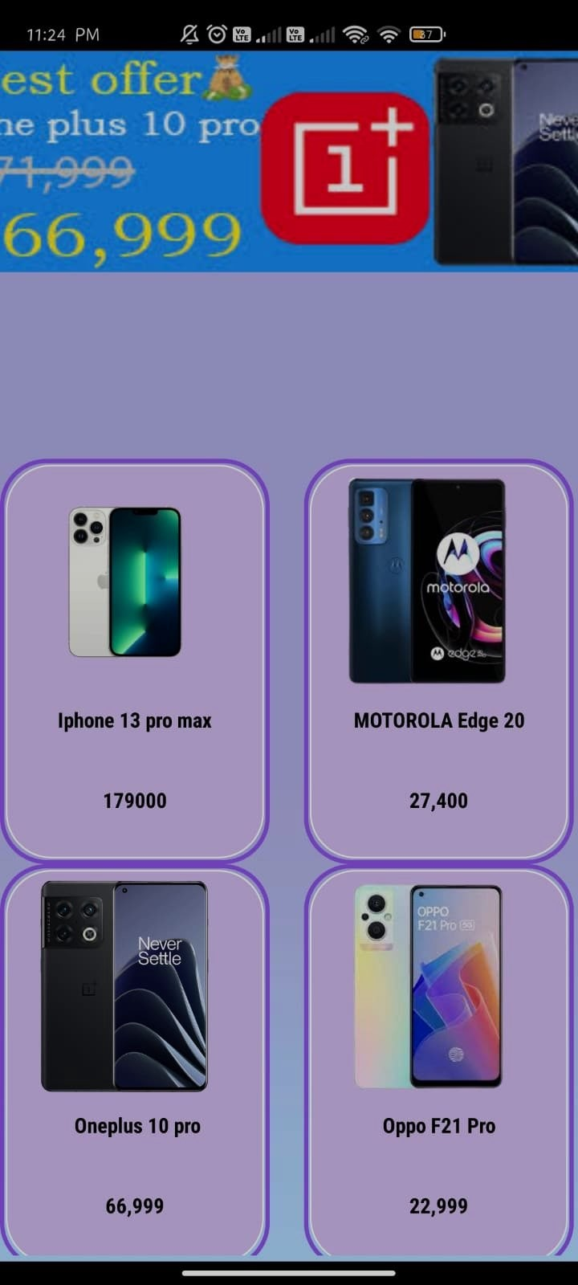
Chat Screen.
Shopping Screen.

Slide 14
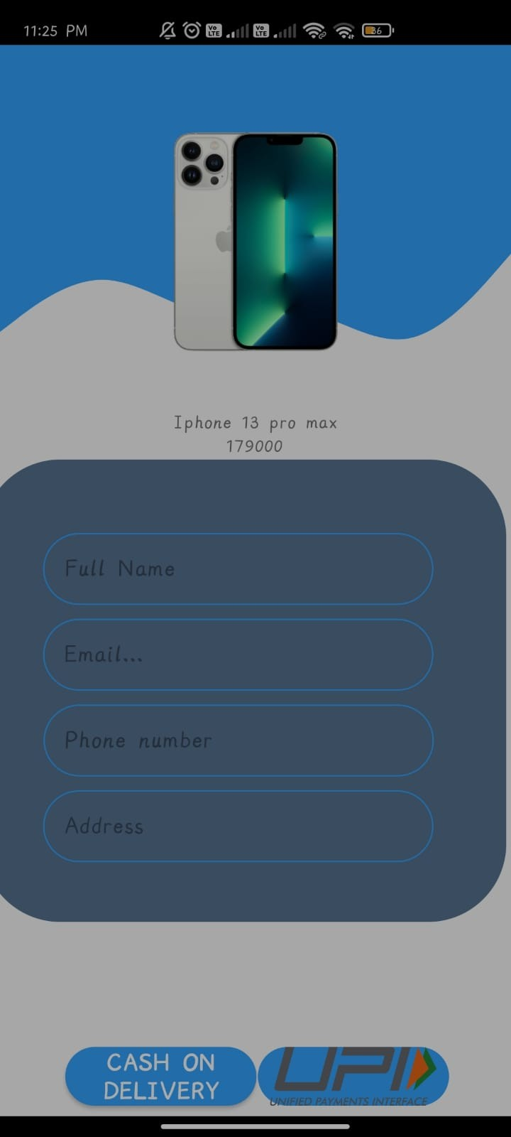
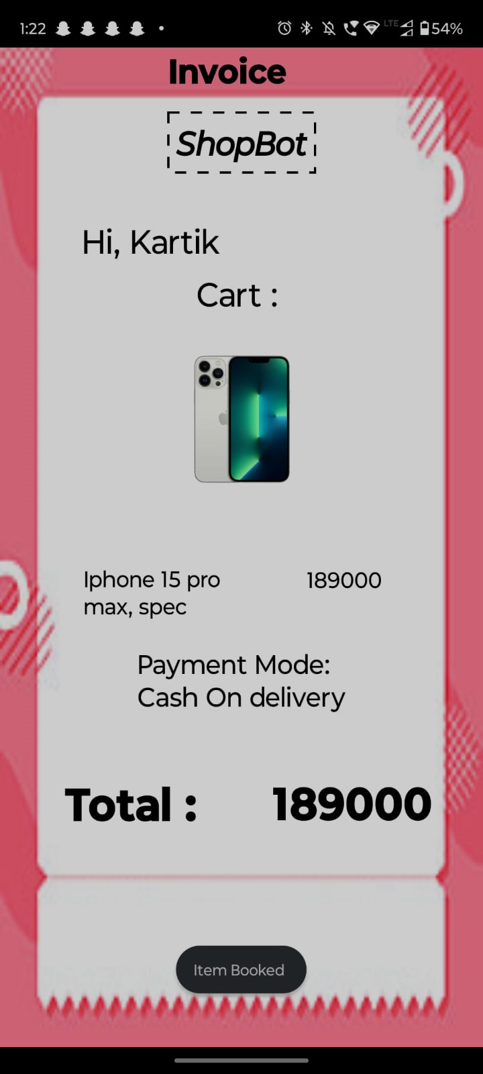
Checkout Screen
Invoice Screen

Slide 15
Conclusion
The development of a SHOPBOT application for Android holds great promise in simplifying and enhancing the mobile shopping experience. With its user-friendly interface, real-time product information, and personalized recommendations, the SHOPBOT has the potential to empower users, reduce decision-making stress, and boost overall satisfaction..

Slide 16
References
[1.]Greenwald, Amy R., and Jeffrey O. Kephart. "Shopbots and pricebots." In Agent Mediated Electronic Commerce II: Towards Next-Generation Agent-Based Electronic Commerce Systems 2, pp. 1-23. Springer Berlin Heidelberg, 2000.
[2.]Tang, Zhulei, Michael D. Smith, and Alan Montgomery. "The impact of shopbot use on prices and price dispersion: Evidence from online book retailing." International journal of industrial organization 28, no. 6 (2010): 579-590.
3.Passyn, Kirsten A., Memo Diriker, and Robert B. Settle. "Price comparison, price competition, and the effects of shopbots." Journal of Business & Economics Research (JBER) 11, no. 9 (2013): 401-416.
4.Pricilla, Catherine, Dessi Puji Lestari, and Dody Dharma. "Designing interaction for chatbot-based conversational commerce with user-centered design." In 2018 5th International Conference on Advanced Informatics: Concept Theory and Applications (ICAICTA), pp. 244-249. IEEE, 2018
[1]https://link.springer.com/chapter/10.1007/10720026_1
[2]https://www.sciencedirect.com/science/article/abs/pii/S0167718710000469
[3]https://www.clutejournals.com/index.php/JBER/article/view/8068
[4]https://ieeexplore.ieee.org/abstract/document/8541320

Slide 17
Thank You...!!

